Slide 1
Observational Uncertainties in Water-Resources Modelling in Central America
Methods for Uncertainty Estimation and Model Evaluation
Introduction and background
Opponent: Alberto Montanari
University of Bologna
Alma Mater Studiorum

Slide 2
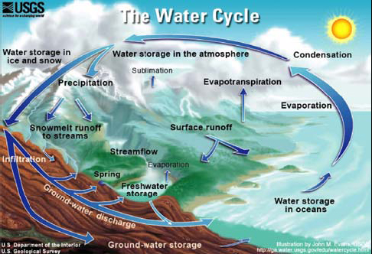
What is hydrology?
From Wikipedia: Hydrology is the study of the movement, distribution, and quality of water on Earth and other planets, including the hydrologic cycle, water resources and environmental watershed sustainability (http://en.wikipedia.org/wiki/Hydrology)
Image from: http://ga.water.usgs.gov/edu/watercycle.html

Slide 3
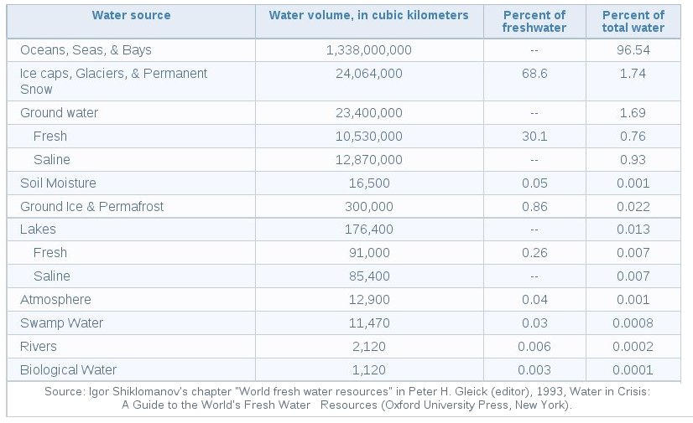
How much water do we have?
From http://ga.water.usgs.gov/edu/earthhowmuch.html

Slide 4
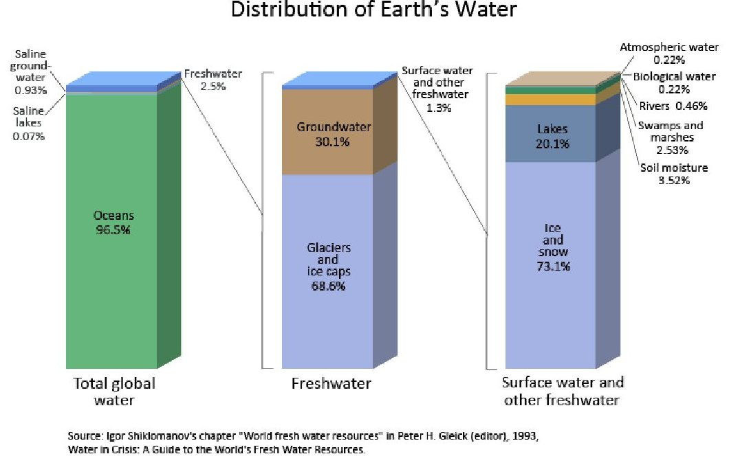
How much water do we have?
From http://ga.water.usgs.gov/edu/earthwherewater.html

Slide 5
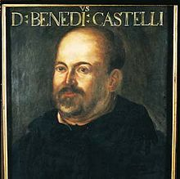
Hydrology is important but is a young science
Until the Middle Age (around 1600 AD) flow in rivers was assumed to mainly come from groundwater and only marginally from rainfall. This was an ancient theory that is attributed to Aristotelis.
Curiously, no one had the idea of observing rainfall and river flows before. Humans started observing stars more than 5000 years ago, but waited until 400 years ago to observe water (with the exception of ancient civilizations, like Egyptians, that collected a few observations of water levels).
Only some 400 years ago an Italian abbé, Benedetto Castelli, postulated that water balance on the Earth is mainly driven by rainfall input. He proved his theory by measuring rainfall with a glass and using the collected data to reconstruct the inflow to the Lake Trasimeno, located in Central Italy.

Slide 6
Hydrology is a young science
The results is that humans do not have long records of water observations (meteorology, water resources….).
The longest rainfall series today available is the one collected in Padua (Italy), which was observed every day from 1725 (with only a few missing values up to today).
If we had longer observation records, we would not spend much time discussing about climate change, water resources variability and so forth.

Slide 7
Why hydrology?
Hydrology aims at understanding the distribution in space and time of water resources.
Given that we have a few chances to assess water resources from data (inductive inference), we need to devise alternative methods. We need to study the water cycle.
Still, we do not know how rainwater reaches the river. We have only a poor knowledge of what happens underground.
And observations are affected by a relevant uncertainty. Observing rainfall and river flows is not easy…..

Slide 8
Why hydrological observations are uncertain?
Rainfall measurements are affected by errors (Westerberg et al., 2010; Beven, 2000), because measuring instruments are still not precise.
River flows cannot be measured with precision. The are indirectly estimated (Westerberg et al., 2011; Pelletier, 1998; Liu et al., 2009) and are therefore affected by relevant uncertainties.
And many other reasons…. (Seibert and McDonnell, 2002; Beven, 2000).
See Beven, 2006: A manifesto for the equifinality thesis. More than 350 citations already.

Slide 9
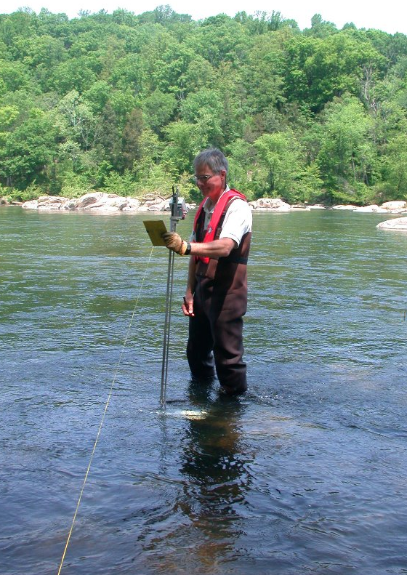
Why hydrological observations are uncertain?
This is the less uncertain river flow measurement that one can take.
Still, there is a relevant uncertainty and this technique cannot be used during floods…. Unless one pays a lot of money!

Slide 10
Quantifying reliability of hydrological data and models is important!
End users needs to know how good information from hydrologists is.
Uncertainty assessment for hydrological predictions is still an open question. Uncertainty assessment in hydrology is very difficult.
There is a general consensus that we need better measuring techniques.
Remote sensing techniques offer interesting perspectives (Halldin, 2004; Di Baldassarre, 2011).

Slide 11
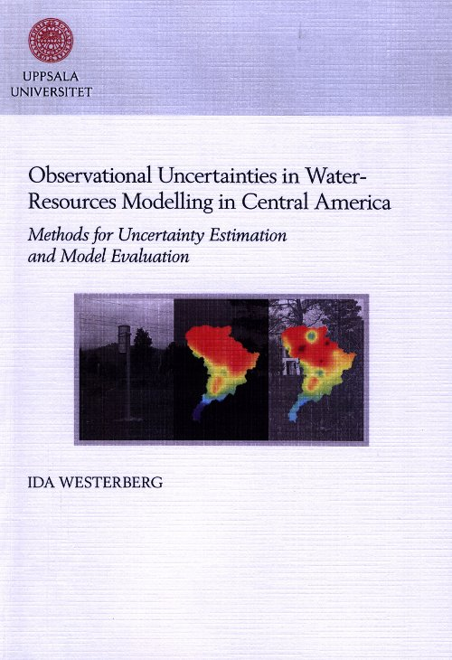
We have relevant open problems that limit our capability to predict hydrology
We strongly need to better understand how rainwater reaches the river (Westerberg et al., 2010; Koutsoyiannis, 2010).
We need to improve techniques for estimating uncertainty of hydrological variables.
We need to better profit from hydrological information and to improve hydrological measurements.

Slide 12
Towards a bright hydrological future
The recent history of hydrology is characterised by relevant progresses.
We need to stimulate an open scientific debate and to stimulate young students.
Interdisciplinarity is fundamental.
Identifying an order of priority is even more important. We must address relevant problems first. Research for the sake of research is a sport, research for the sake of solving water problems is a humanitarian need.
The future is bright if/because young scientists are bright. Education is the key. Water is fun! (Seibert, 2011).

