Slide 1
How likely is the likelihood? A note on parameter estimation for hydrological models
Alberto Montanari
Dipartimento di Ingegneria Civile, Chimica Ambientale e dei Materiali (DICAM)
Alma Mater Studiorum – Università di Bologna
alberto.montanari@unibo.it
This work is carried out within the SWITCH-ON Research Project financed by the European Union within the 7th Framework Programme, and the Panta Rhei research initiative of the International Association of Hydrological Sciences

Slide 2
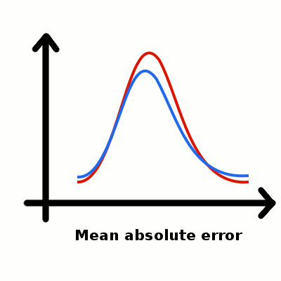
Motivation
The selection of the objective function for calibrating hydrological models is still a delicate task, impacting hydrological practice.
Thanks to recent valuable contributions, there is an increasing pressure to optimise hydrological models by maximising their likelihood. This recommendation is frequently suggested and adopted without realising its practical implications.
The purpose of this study is to investigate, from an engineering perspective, what are the implications of using a likelihood for calibrating hydrological models.
What is a likelihood?
From Wikipedia: In statistics, a likelihood function (often simply the likelihood) is a function of the parameters of a statistical model. The likelihood of a set of parameter values, θ, for given outcomes, is equal to the probability of those observed outcomes given those parameter values, that is: L(θ|x) = P(x |θ).

Slide 3
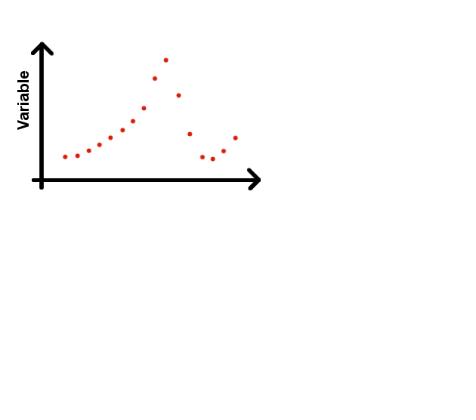
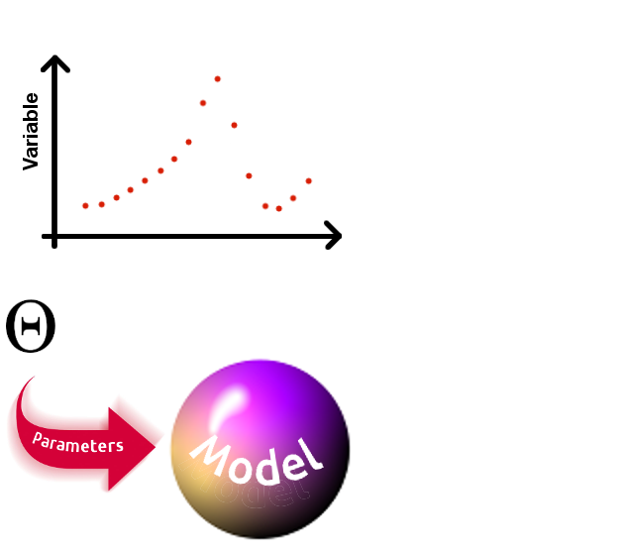
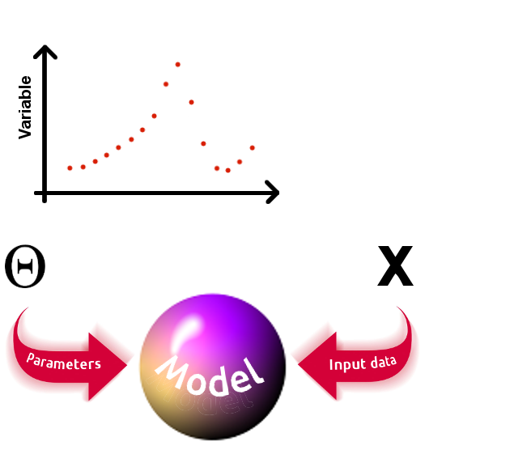
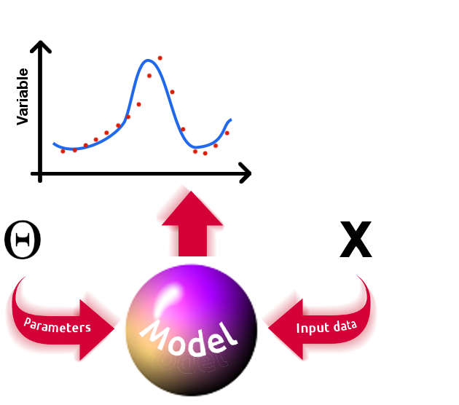
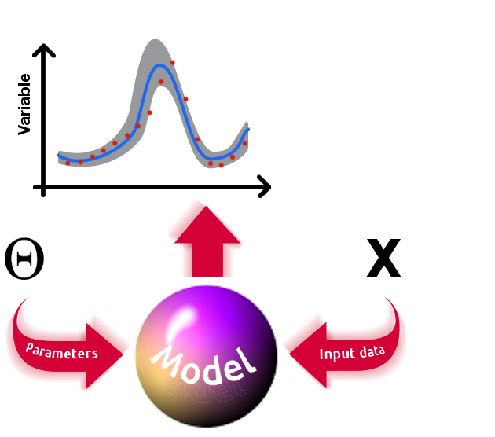
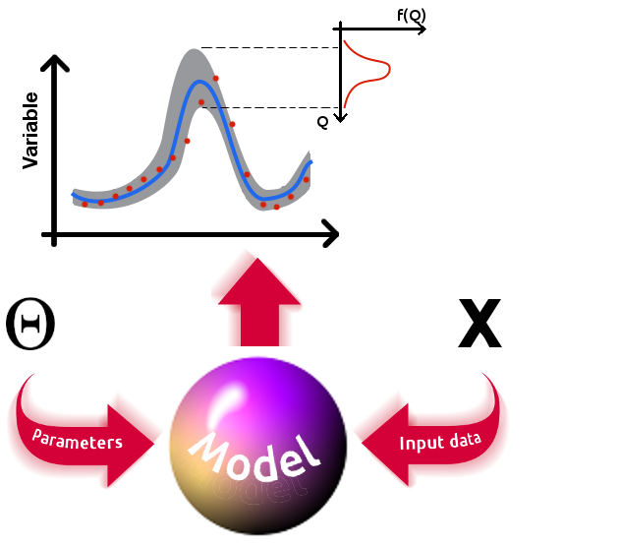
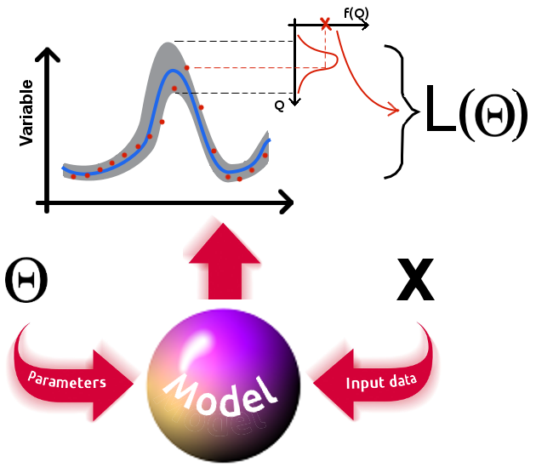
How likelihood is computed in practice?
Assumptions
What if assumptions are not satisfied? Probabilities and likelihood are not well estimated. See next slides.

Slide 4
Implications of the definition
For a given model, parameter set and observations the likelihood is fixed.
The likelihood is a probability and not a probability distribution.
The likelihood is a perfect candidate for the objective function.
The likelihoods depends on predictive uncertainty.

Slide 5
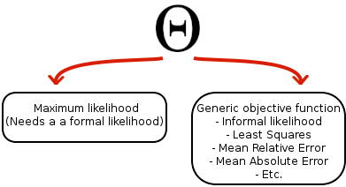
What is the effect of assumptions?
The likelihood is conditioned by assumptions that are rarely met in hydrology. The most common assumption is independence and heteroscedasticity of model residuals.
Recent contributions proposed new formulations for the likelihood (Schoups and Vrugt, 2009; Pianosi and Raso, 2012). However, the fit provided by the likelihood is still not satisfactory in many cases.
If the assumptions are violated, then the probability of the observed data is not well estimated, at least for some data points.
My conclusion is that the likelihood is no more a likelihood if its assumptions are violated. It becomes just another objective function.
Remember: we often speak of “true” model parameters. Actually, if the model is uncertain a true parameter set does not exist. We have several optimal parameter sets (along with their probability distributions), one for each objective function we may consider.

Slide 6
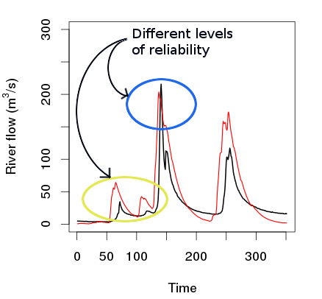
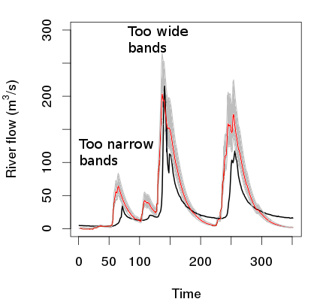
Some preliminary conclusions
If the assumptions conditioning the likelihood are violated (99% of the cases), then:
- Parameters estimation is biased: namely, the model does not reproduce all the data with the same reliability, but some data (e.g. floods) are better simulated than others (e.g. droughts ).
Uncertainty for the model output is not correctly estimated: for some data (e.g. floods) uncertainty maybe correctly estimated, while for others ((e,g. droughts) not.
The objective function should be identified by considering the purpose of the analysis and the behaviour of each candidate from a practical point of view.
It is necessary to study the behaviours of the objective functions (for some of them the behaviours are well known already) and the behaviours of the considered likelihood formulation, with the awareness that it is not a likelihood.

Slide 7
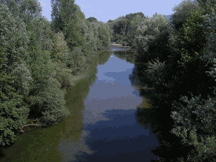
Case study: behaviours of objective functions
Sieve River Basin (Tuscany region – Italy) – Contributing area 822 km²
Hourly rainfall, evapotranspiration, river flow for the period 1992 – 1996
Hymod rainfall-runoff model: lumped, 5 parameters
Calibration and validation performed for the 1992 – 1994 and 1995 – 1996 periods, respectively.
Optimal parameter set obtained by minimising:
- Sum of squared residuals.
- Sum of absolute errors.
- Parametric approximate maximum likelihood (autoregressive model of order 1 estimated for the residuals) with autoregressive parameter estimated off-line with respect to hydrological model parameters.
Optimization of objective functions has been carried out by using DREAM (Vrugt et al., 2008)
Sieve River at Pontassieve

Slide 8
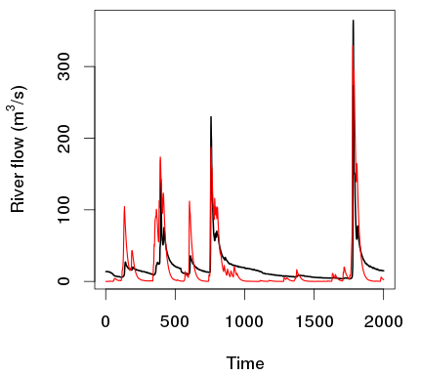
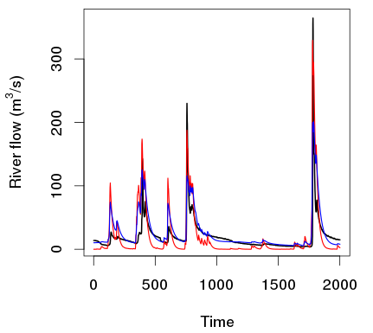
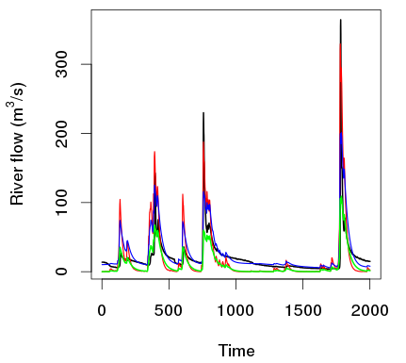
Analysis of the objective functions’ behaviours
Sum of squares:
- Calibration: Nash-Sutcliffe efficiency = 0.73
- Validation: Nash-Sutcliffe efficiency = 0.47
Sum of absolute errors:
- Calibration: Nash-Sutcliffe efficiency = 0.64
- Validation: Nash-Sutcliffe efficiency = 0.65
Approximate maximum likelihood:
- Calibration: Nash-Sutcliffe efficiency = 0.44
- Validation: Nash-Sutcliffe efficiency = 0.50
-- Observed data
-- Least squares
-- Absolute error
-- MLE
For each of the three objective functions the distribution of the parameters was checked to assess if the optimum is well identified

Slide 9
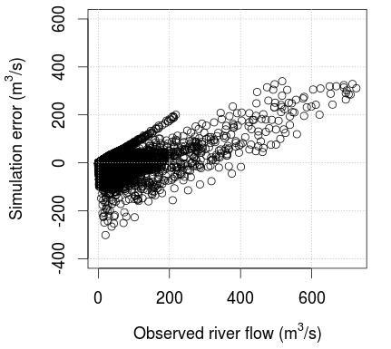
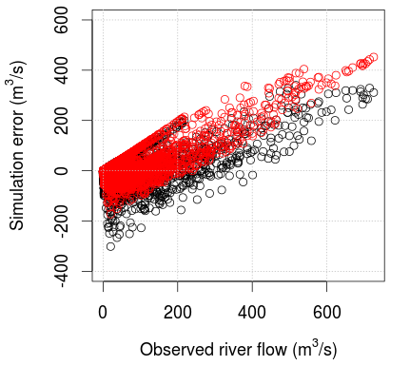
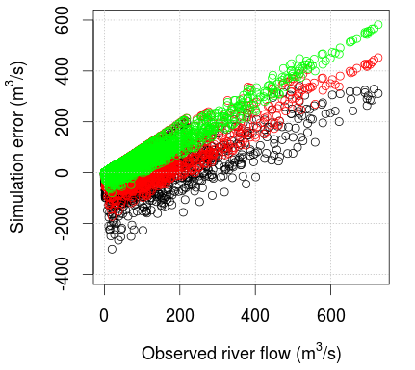
Analysis of the objective functions’ behaviours
Sum of squares:
- Calibration: Nash-Sutcliffe efficiency = 0.73
- Validation: Nash-Sutcliffe efficiency = 0.47
Sum of absolute errors:
- Calibration: Nash-Sutcliffe efficiency = 0.64
- Validation: Nash-Sutcliffe efficiency = 0.65
Approximate maximum likelihood:
- Calibration: Nash-Sutcliffe efficiency = 0.44
- Validation: Nash-Sutcliffe efficiency = 0.50
O Least squares
O Absolute errors
O MLE

Slide 10
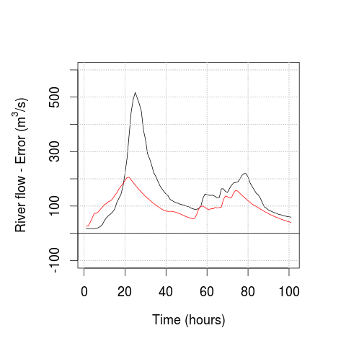
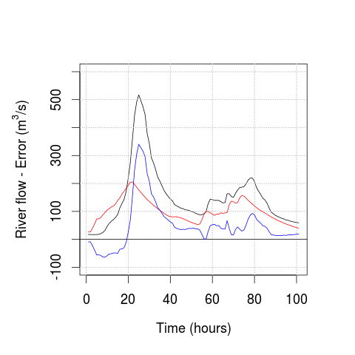
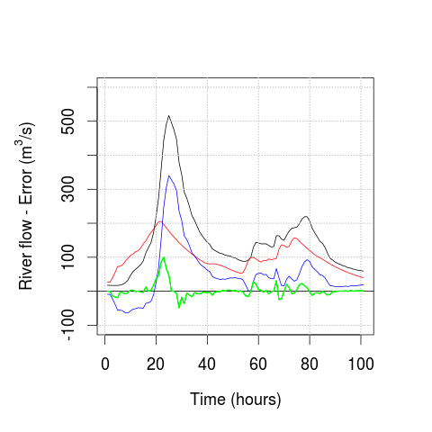
Why maximum likelihood is more focused on droughts?
----- Observed flow
----- Least squares simulation
----- Least squares error
----- MLE error
Let us focus on a generic flood event for the Sieve River and the related simulation error
The shock produced by the occurrence of a flood that is incorrectly predicted by the model lasts very long if the error is correlated. The same shock is repeated for several time steps and the related error is squared. Parameterisation is much focused on floods.
If the error is decorrelated the shock lasts for a few steps only. Less focus on floods.

Slide 11
Conclusions
The likelihood is not likely!
There is no theoretical reason to prefer the use of a likelihood if assumptions are not satisfied.
On the other hand, approximate likelihoods should be considered as candidate objective functions, but their behaviours should be inspected.
The objective function should be selected by considering the purpose of the analysis and the behaviours of the candidate functions.
More research is needed on alternative objective functions and their behaviours, in terms of shape of the response surface and capability to meet practical needs. Such additional research should clearly highlight the asset of each proposed function. Such research should not be focused on likelihoods only. We dedicated a lot of attention to optimization but little to objective functions.
Practical experience suggests that a proper objective function, taking into account that a hydrological model is never perfect, may improve model performances significantly.

Slide 12
www.iahs.info/pantarhei
Call for research themes and working groups coming soon

Slide 13
www.iahs.info/bologna2014
Final deadline: March 15, 2014

