Slide 1
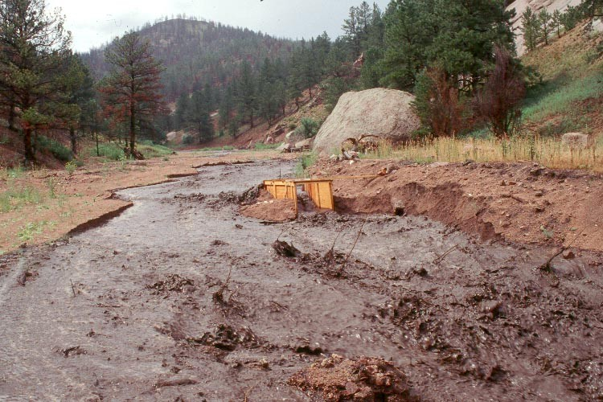
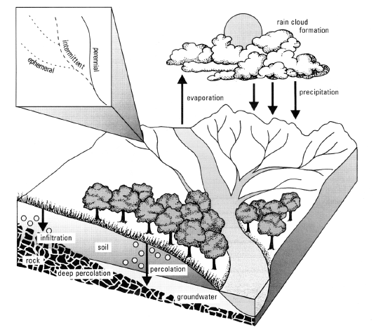
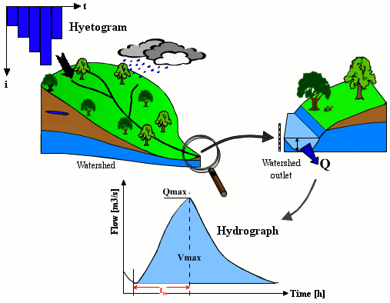
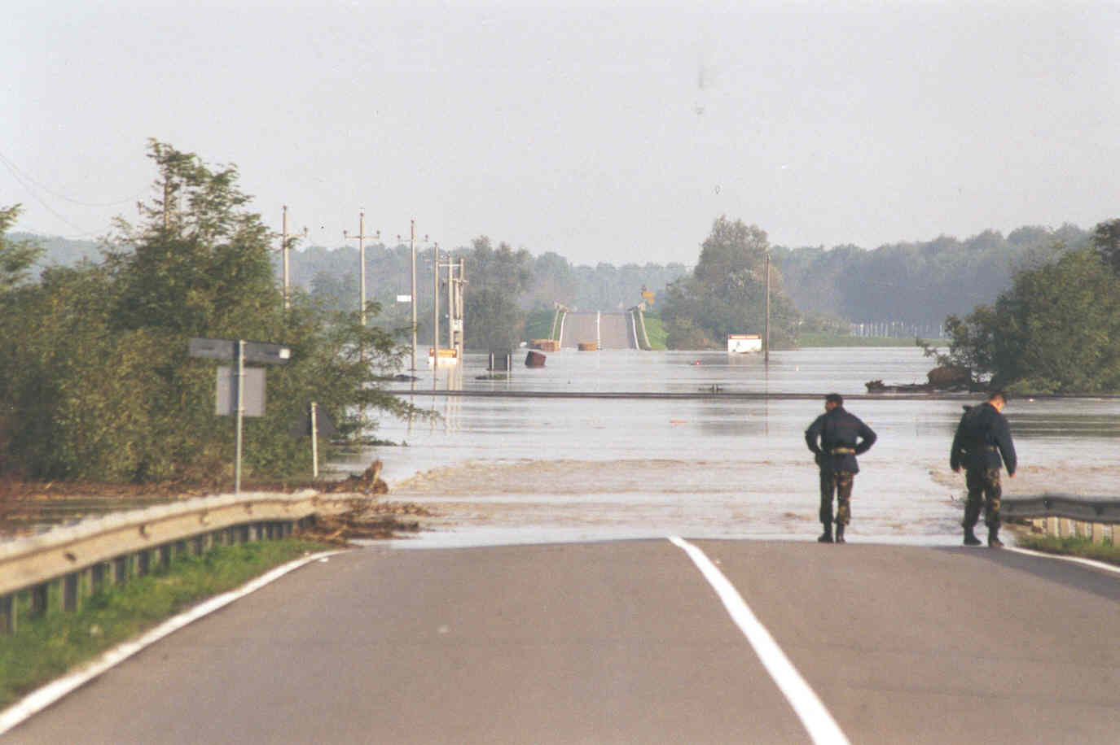
Infiltration models
Alberto Montanari
University of Bologna

Slide 2
Infiltration models
Infiltration models are a crucial issue for rainfall runoff modelling.
Infiltration modelling is embedded in some models like Hymod. However, it is important to realise how they account for it.
Hortonian vs Dunnian approaches (infiltration excess vs excess of saturation).
Fixed threshold and percentage model.

Slide 3
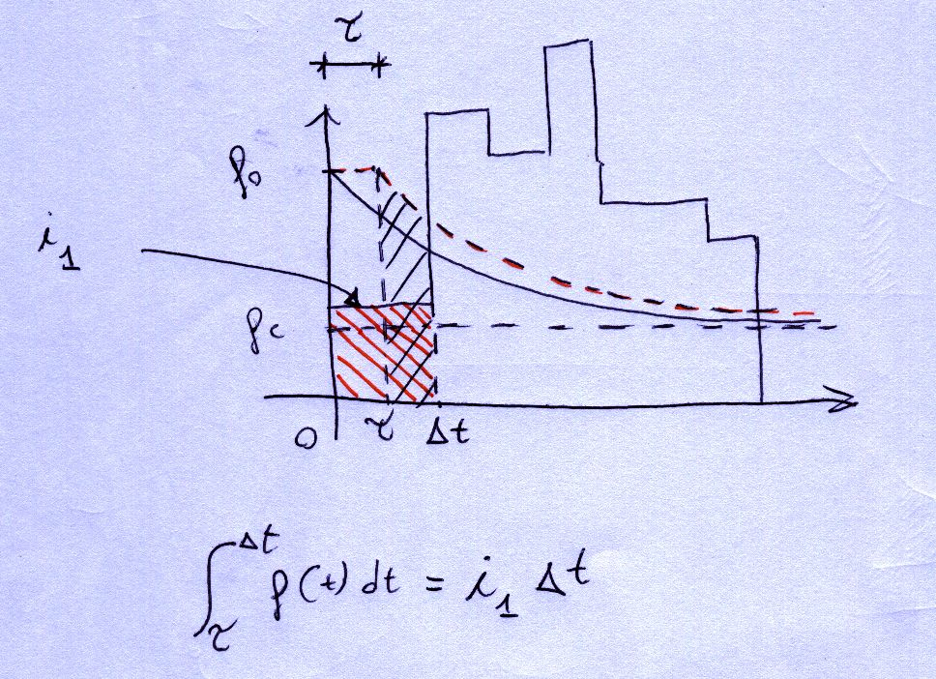
Horton model
Hortonian approach – Very classical
Need to define initial and asymptotic infiltration rates.
f(t) = f_{c} + (f₀-f_{c}) e^{-t/k}
Need to shift the curve when rainfall is lower than infiltration potential

Slide 4
SCS-CN model
Conceptual model

Slide 5
Rainfall-Runoff modelling: final considerations
Model identification, calibration and validation
A proper identification of the most appropriate model should take into account the real world purposes as well as pros and cons of each modelling approach:
- Event based versus continuous simulation models;
- Lumped versus distributed models (these latter not treated during these classes);
- Physically-based versus conceptual models;
- Computational requirements.

