Slide 1
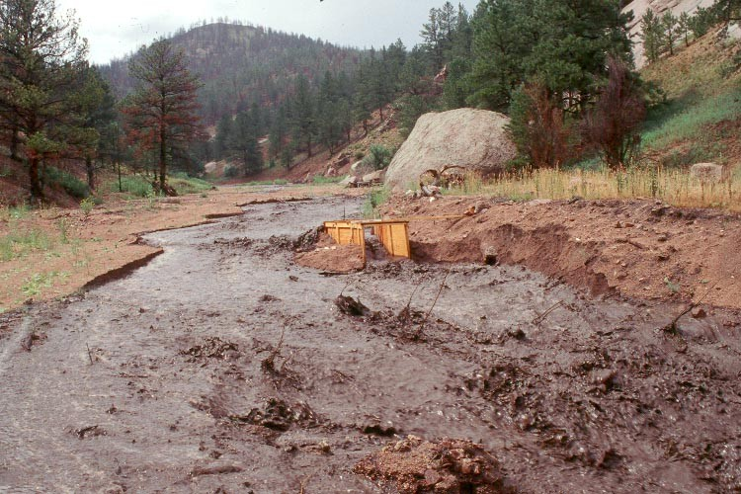
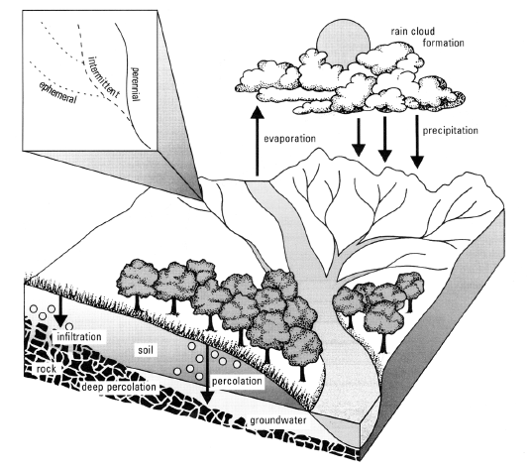
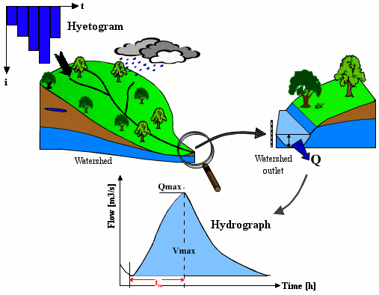
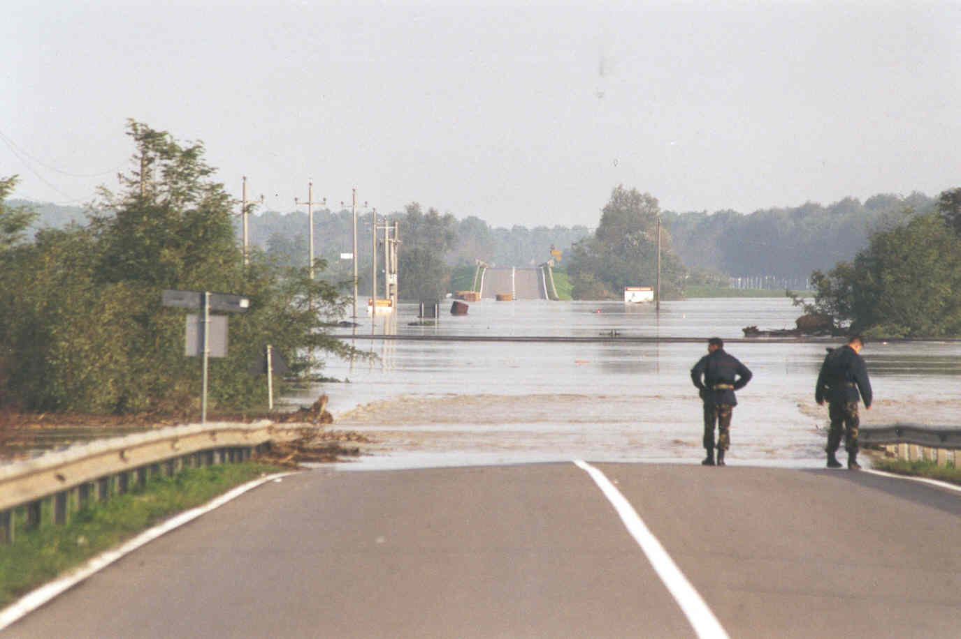
Simulation of synthetic rainfall series
Alberto Montanari
University of Bologna

Slide 2
Rainfall models
Rainfall data are usually more readily available than river flow observations.
When sufficiently long series are not available one usually makes use of rainfall simulation.
In this subject we do not treat rainfall models in detail.
Rainfall simulation is usually performed by using stochastic point processes.
The most used approach is the Neyman-Scott rectangular pulses model.

Slide 3
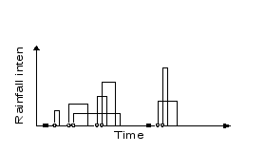
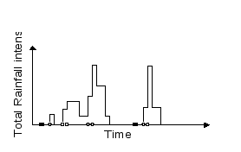
Neyman Scott model
Rainfall is assumed to be described by a composition of rectangular rain cells. The occurrence of a rainfall event, the number of cells, their duration and intensity, and their interarrival times, are assumed to be described by random processes.
The model counts 5 parameters that are estimated by maximising the fit of the statistics of observed rainfall data

Slide 4
Multivariate rainfall models
The Neyman Scott model can be expressed in multivariate form, to simulate rainfall in more than one raingauge.
Multivariate simulation is computer intensive and is usually limited to 3-5 raingauges.
Other rainfall models can be used.
There are no commercial softwares for rainfall generation. It is usually a complicated task.

