Slide 1
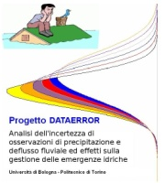
2010 AGU Fall Meeting
San Francisco, 13 - 17 December 2010
Is deterministic physically-based hydrological modeling a feasible target? Incorporating physical knowledge in stochastic modeling of uncertain systems
Alberto Montanari Faculty of Engineering University of Bologna alberto.montanari@unibo.it | Demetris Koutsoyiannis National Technical University of Athens dk@ntua.itia.gr
Work carried out under the framework of the Research Project DATAERROR
(Uncertainty estimation for precipitation and river discharge data. Effects on water resources planning and flood risk management)
Ministry of Education, University and Research - Italy

Slide 2
A premise on terminology
Physically-based, spatially-distributed and deterministic are often used as synonyms. This is not correct.
Physically-based model: based on the application of the laws of physics. In hydrology, the most used physical laws are the Newton’s law of the gravitation and the laws of conservation of mass, energy and momentum.
Sir Isaac Newton (1689, by Godfrey Kneller)
Spatially-distributed model: model’s equations are applied at local instead of catchment scale. Spatial discretization is obtained by subdividing the catchment in subunits (subcatchments, regular grids, etc).
Deterministic model: model in which outcomes are precisely determined through known relationships among states and events, without any room for random variation. In such model, a given input will always produce the same output

Slide 3
A premise on terminology
Fluid mechanics obeys the laws of physics. However:
Most flows are turbulent and thus can be described only probabilistically (note that the stress tensor in turbulent flows involves covariances of velocities).
Even viscous flows are au fond described in statistical thermodynamical terms macroscopically lumping interactions at the molecular level.
It follows that:
A physically-based model is not necessarily deterministic.
A hydrological model should, in addition to be physically-based, also consider chemistry, ecology, etc.
In view of the extreme complexity, diversity and heterogeneity of meteorological and hydrological processes (rainfall, soil properties…) physically-based equations are typically applied at local (small spatial) scale. It follows that:
A physically-based model often requires a spatially-distributed representation.

Slide 4
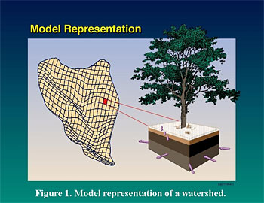
A premise on terminology
In fact, some uncertainty is always present in hydrological modeling. Such uncertainty is not related to limited knowledge (epistemic uncertainty) but is rather unavoidable.
It follows that a deterministic representation is not possible in catchment hydrology.
The most comprehensive way of dealing with uncertainty is statistics, through the theory of probability.
Therefore a stochastic representation is unavoidable in catchment hydrology (sorry for that... ). The way forward is the stochastic physically-based model, a classical concept that needs to be brought in new light.
Figure taken from http://hydrology.pnl.gov/

Slide 5
Formulating a physically-based model within a stochastic framework
Hydrological model:
in a deterministic framework, the hydrological model is usually defined as a single-valued transformation expressed by the general relationship:
Q_{p} = S (ε, I)
where Q_{p} is the model prediction, S expresses the model structure, I is the input data vector and ε the parameter vector.
In the stochastic framework, the hydrological model is expressed in stochastic terms, namely (Koutsoyiannis, 2010):
f_{Qp} (Q_{p}) = K f_{ε, I}(ε, I)
where f indicates the probability density function, and K is a transfer operator that depends on model S.

Slide 6
Formulating a physically-based model within a stochastic framework
Assuming a single-valued (i.e. deterministic) transformation S(ε, I) as in previous slide, the operator K will be the Frobenius-Perron operator (e.g. Koutsoyiannis, 2010).
However, K can be generalized to represent a so-called stochastic operator, which corresponds to one-to-many transformations S.
A stochastic operator can be defined using a stochastic kernel k(e, ε, I) (with e intuitively reflecting a deviation from a single-valued transformation; in our case it indicates the model error) having the properties
k(e, ε, I) ≥ 0 and ∫_{e} k(e, ε, I) de = 1

Slide 7
Formulating a physically-based model within a stochastic framework
Specifically, the operator K applying on f_{ε, I} (ε, I) is then defined as (Lasota and Mackey, 1985, p. 101):
K f _{ε, I}(ε, I) = ∫_{ε} ∫_{I} k(e, ε, I) f_{ε, I} (ε, I) dε dI
If the random variables ε and I are independent, the model can be written in the form:
f_{Qp}(Q_{p}) = K [f_{ε}(e) f_{I} (I)]
f_{Qp} (Q_{p}) = ∫_{ε} ∫_{I} k(e, ε, I) f_{ε} (ε) f_{I} (I) dε dI

Slide 8
Formulating a physically-based model within a stochastic framework
Estimation of prediction uncertainty:
Further assumptions:
1) model error is assumed to be independent of input data error and model parameters.
2) Prediction is decomposed in two additive terms, i.e. :
Q_{p} = S(ε, I) + e
where S represents the deterministic part and the structural error e has density f_{e}(e).
4) Kernel independent of ε, I (depending on e only), i.e.:
k(e, ε, I) = f_{e}(e)
By substituting in the equation derived in the previous slide we obtain:
f_{Qp}(Q_{p}) = ∫_{ε} ∫_{I} f_{e}(Q_{p} - S(ε, I)) f_{ε} (ε) f_{I} (I) dε dI

Slide 9
Formulating a physically-based model within a stochastic framework
Symbols:
- Q_{p} true (unknown) value of the hydrological variable to be predicted
- S(ε,I) Deterministic hydrological model
- e Model structural error
- ε Model parameter vector
- I Input data vector
From the deterministic formulation:
Q_{p} = S(ε, I)
to the stochastic simulation:
f_{Qp}(Q_{p}) = ∫_{ε} ∫_{I} f_{e}(Q_{p} - S(ε, I)) f_{ε}(ε) f_{I}(I) dε dI

Slide 10
Formulating a physically-based model within a stochastic framework
An example of application: model is generic and possibly physically-based. Let us assume that input data uncertainty can be neglected, and that probability distributions of model error and parameters are known.
Obtain n • j points lying on f_{Qp} (Q_{p}) and infer the probability distribution
Repeat j times
Compute model output and add n realisation of model error from probability distribution f_{e}(e)
p(x)
Pick up a parameter vector ε from the model parameter space accordingly to probability f_{ε}(ε)
Input data vector
(certain)
Problems:
computational demands;
estimate f_{ε} (ε) and f_{e} (e)

Slide 11
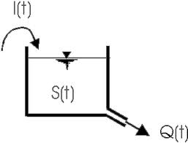
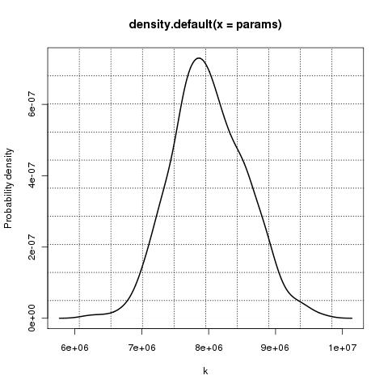
Example: linear reservoir rainfall-runoff model at monthly time scale
Synthetic data: monthly rainfall is Gaussian and independent. Monthly river flow Q’(t) is generated with a linear reservoir model with parameter g = 800.000 s. Finally, river flow data are corrupted to account for model structural uncertainty:
Q(t) = Q’(t) + c(t) Q’(t)
where c(t) is a realisation from a Gaussian white noise.
Calibration of g was performed over a sample of 1500
observations by using DREAM (Vrugt and Robinson, 2007).
Probability density distribution of g turned out to be Gaussian with
mean value equal to 800.000.
Linear reservoir
Probability density of g

Slide 12
Estimation of the predictive distribution
We estimated model predictive distribution by using 1500 “new” rainfall data in input to the linear reservoir model. We sampled 200 values from the parameter distribution and generated 200 “deterministic predictions”.
Then, to each prediction and for each time t we added 100 outcomes from the probability distribution of the model error e.
95% confidence bands and true values

Slide 13
Research challenges
To include a physically-based model within a stochastic framework is in principle easy. Nevertheless, relevant research challenges need to be addressed:
numerical integration (e.g. by Monte Carlo method) is computationally intensive and may result prohibitive for spatially-distributed models. There is the need to develop efficient simulation schemes;
a relevant issue is the estimation of model structural uncertainty, namely, the estimation of the probability distribution f(e) of the model error. The literature has proposed a variety of different approaches, like the GLUE method (Beven and Binley, 1992), the meta-Gaussian model (Montanari and Brath, 2004; Montanari and Grossi, 2008), Bayesian Model Averaging. For focasting, Krzysztofowicz (2002) proposed the BFS method;
estimation of parameter uncertainty is a relevant challenge as well. A possibility is the DREAM algorithm (Vrugt and Robinson, 2007).

Slide 14
Concluding remarks
A deterministic representation is not possible in hydrological modeling, because uncertainty will never be eliminated. Therefore, physically-based models need to be included within a stochastic framework.
The complexity of the modeling scheme increases, but multiple integration can be easily approximated with numerical integration.
The computational requirements may become very intensive for spatially-distributed models.
How to efficiently assess model structural uncertainty is still a relevant research challenge, especially for ungauged basins.
MANY THANKS to: Guenter Bloeschl, Siva Sivapalan, Francesco Laio
http://www.albertomontanari.it - alberto.montanari@unibo.it

Slide 15
References
Beven, K.J., Binley, A.M., The future of distributed models: model calibration and uncertainty prediction. Hydrological Processes 6: 279–298, 1992.
Koutsoyiannis, D., A random walk on water, Hydrology and Earth System Sciences Discussions, 6, 6611–6658, 2009.
Krzysztofowicz, R., Bayesian system for probabilistic river stage forecasting, Journal of Hydrology, 268, 16–40, 2002.
Lasota, D.A., Mackey, M.C., Probabilistic properties of deterministic systems, Cambridge Universityy Press, 1985.
Montanari, A., Brath, A., A stocastic approach for assessing the uncertainty of rainfall-runoff simulations. Water Resources Research, 40, W01106, doi:10.1029/2003WR002540, 2004.
Montanari, A., Grossi, G., Estimating the uncertainty of hydrological forecasts: A statistical approach. Water Resources Research, 44, W00B08, doi:10.1029/2008WR006897, 2008.
Vrugt, J.A and Robinson, B.A., Improved evolutionary optimization from genetically adaptive multimethod search, Proceedings of the National Academy of Sciences of the United States of America, 104, 708-711, doi:10.1073/pnas.06104711045, 2007.
http://www.albertomontanari.it - alberto.montanari@unibo.it

