Slide 1
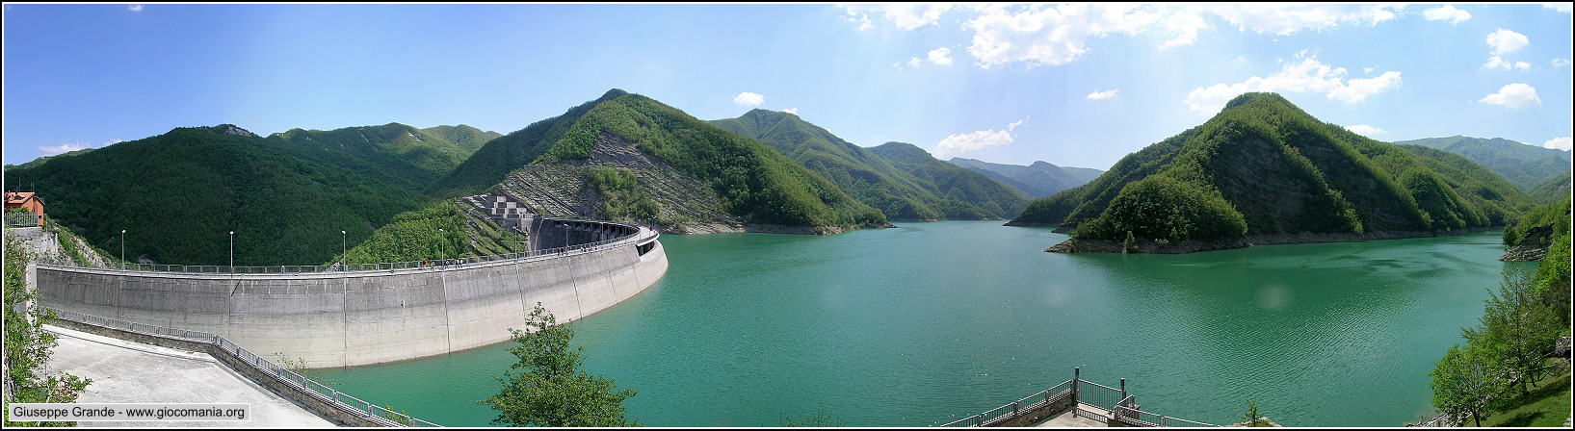
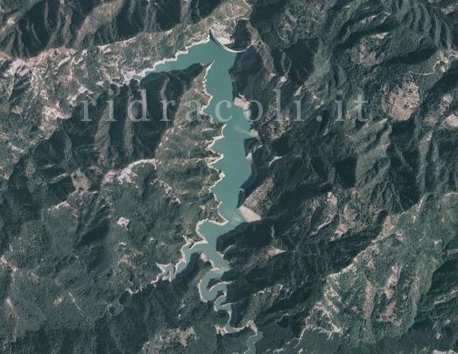
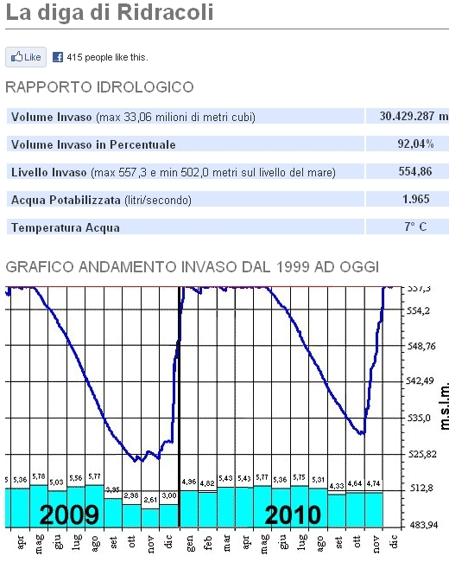
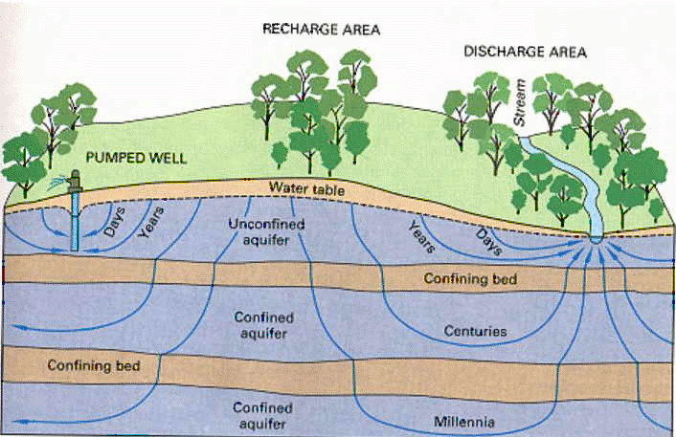
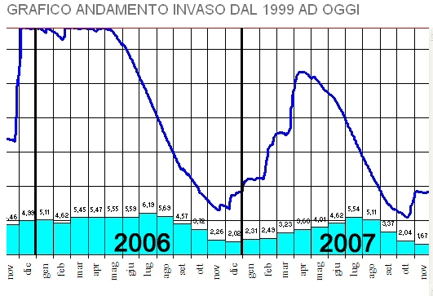
Dams
http://www.ridracoli.it/ 23rd may 2011
… Or ??

Slide 2
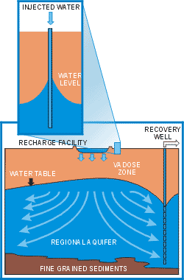
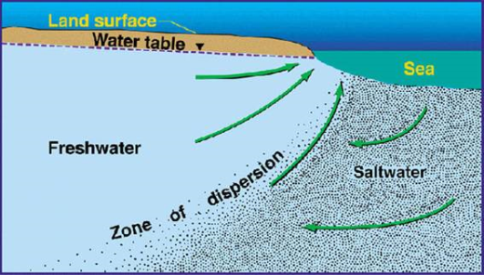
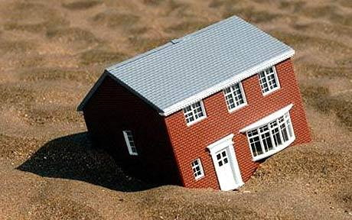
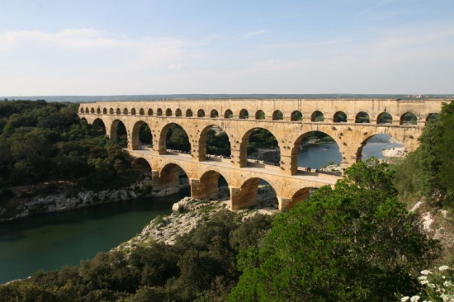
Artificial Recharge of Groundwater
Artificial recharge systems are engineered systems where surface water is put on or in the ground for infiltration and subsequent movement to aquifers to augment groundwater resources.
http://www.hoses.co.za/index.php?page=boreline-applications
Objectives:
    To store water
    To make groundwater out of surface water where groundwater is traditionally preferred for drinking
    To reduce seawater intrusion
    To reduce subsidence
    To use aquifers as water conveyance systems (as an aqueduct without pipes)
    To improve the quality of the water through soil-aquifer treatment or geopurification
http://water.usgs.gov/ogw/gwrp/saltwater/salt.html
http://www.telegraph.co.uk/property/propertyadvice/propertyclinic/7251914/Subsidence-what-you-need-to-know.html
Artificial recharge of groundwater: hydrogeology and engineering, Herman Bouwer, Hydrogeology Journal (2002)

Slide 3
Artificial Recharge of Groundwater
The traditional way of storing water has been with dams
Disadvantages:
good dams sites are becoming scarce
evaporation losses (up to 2 m/year in warm, dry climates)
sediment accumulation at the bottom (losses of volume)
potential of structural failure (earthquake)
potential vector of waterborne diseases
adverse ecological, environmental and socio-cultural effects
…
“Global climate changes increase the probability of extremes in weather such as more frequent droughts and excessive rain. These conditions, along with increasing population, increase the need for storing excess water in wet periods to meet the water demand in dry periods.”
They are not effective for long-term storage of water

Slide 4
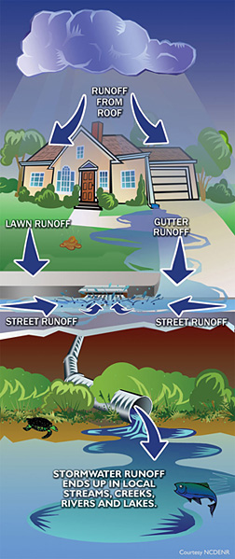
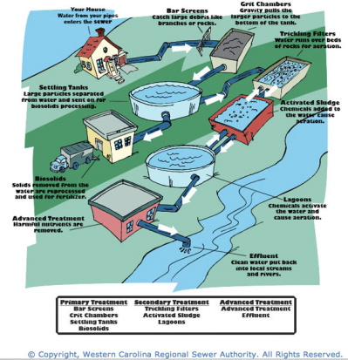
Artificial Recharge of Groundwater
In order to plan an effective artificial groundwater recharge action we need to consider:
° availability of water ( good quantity of good quality)
!physical-chemical features! !turbidity!
° deep knowledge of the soil and the hydrogeology
cracking, karst formation, areas characterized by different permeability, divide position, permeability (v. and o.), porosity, capillarity………..
Water sources for artificial recharge include water from:
    perennial or intermittent stream (regulated or not with low dams);
    aqueducts or drinking-water treatment plants;
    storm runoff [including that obtained with urbanization; most of the land is covered with streets, driveways, roofs, and other impermeable surfaces that produce more runoff – it can be collected for on-site storage and artificial recharge];
    irrigation districts;
    sewage-treatment plants.
Notes:
4

Slide 5
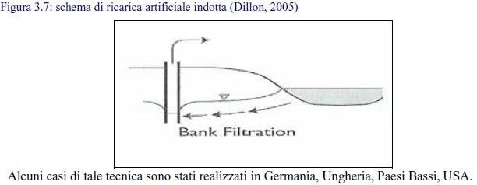
Artificial Recharge of Groundwater
Artificial recharge systems can be direct or induced
Induced recharge is achieved by placing wells relatively close to streams or rivers, so that more river water is “pulled” into the aquifer as water table near the streams are lowered by pumping the wells. The main objective of these “bank filtration” systems is often to get pretreatment of the river water as it moves through the river bottom materials and the aquifers before it is pumped up for conventional drinking-water treatment and public water supply. Bank filtration is used particularly where river water is contaminated or where the public prefers groundwater over surface water. The distance between river and wells is crucial, because the travel time has to be long enough to naturally improve the river water quality.
Notes:
5

Slide 6
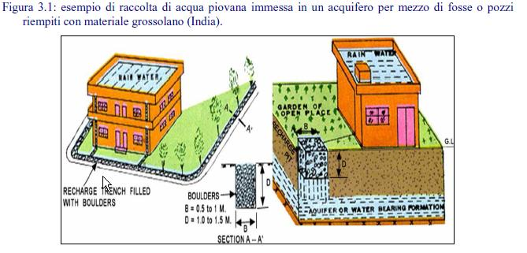
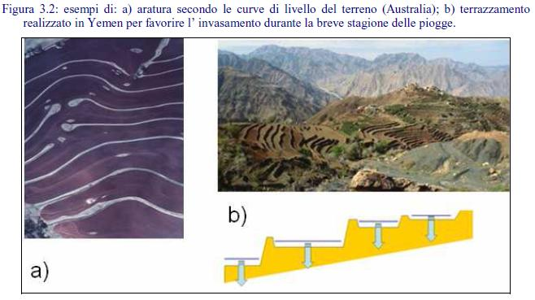
Artificial Recharge of Groundwater
Few examples of direct artificial recharge systems:
Storm runoff coming from roofs is collected in wells or trenches (filled with coarse backfill)
The soil can be ploughed along the contour lines creating terracings to easily catch the surface runoff
Notes:
6

Slide 7
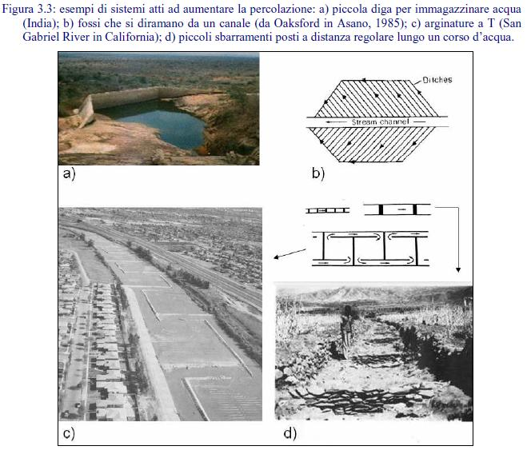
Artificial Recharge of Groundwater
Few examples of direct artificial recharge systems: surface infiltration systems
In-channel systems consists of dams placed across ephemeral of perennial streams to back the water up and spread it out thus increasing the wetted area of the streambed or the floodplain so that more water infiltrates into the ground
Notes:
7

Slide 8
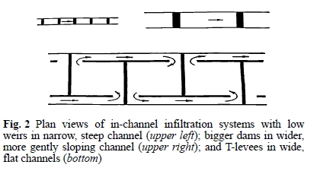
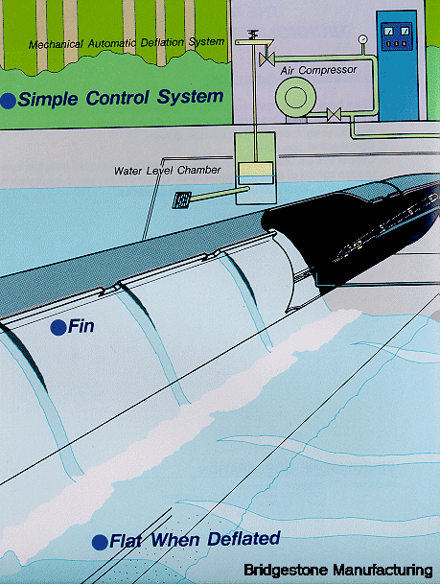
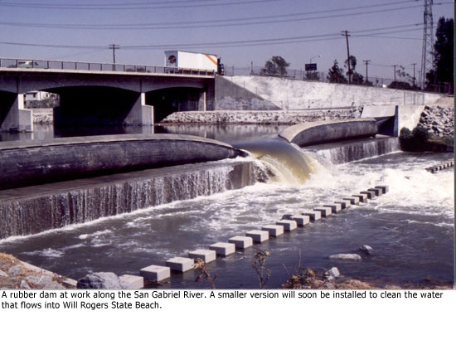
Artificial Recharge of Groundwater
In-channel systems:
Some dams consists of low weirs spaced a small distance apart; others are larger dams spaced a greater distance apart. Where channels have small slopes and water depth, water is spread over the entire width of the channel or floodplain by placing T- or L-shaped earthen levees about 1 m high in the channel.
Materials:
Steel weirs, earth dams (L- and T-shaped levees are pushed up by bulldozer using natural streambed sands), concrete dams or inflatable rubber dams are used.
For big floods they are deflated to lie flat on their foundations
Notes:
8

Slide 9
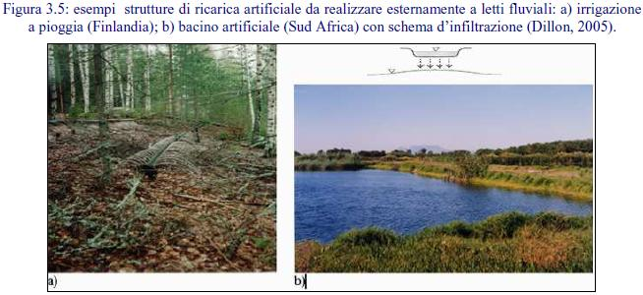
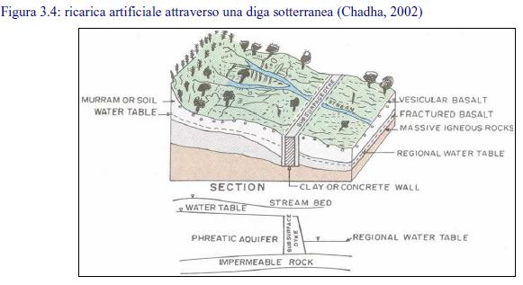
Artificial Recharge of Groundwater
Off-channel systems:
Consists of specially constructed infiltration basins, lagoons, old gravel pits, flood irrigated fields, perforated pipes, or any other facility where water is put or spread on the ground for infiltration into the soil and movement to underlying groundwater.
Subsurface dams: they have to lay over an impermeable rock layer.
The bane of all artificial recharge systems!
Attention:
water sources of adequate quality to prevent undue CLOGGING (pretreatment to reduce suspended solids, nutrients, organic carbon; regular drying of the system to enable drying and cracking of the clogging layer.
surface infiltration systems require permeable surface soils to get high infiltration rates
soils, vadose zones and aquifers should be free from undesirable contaminants.
Notes:
9

Slide 10
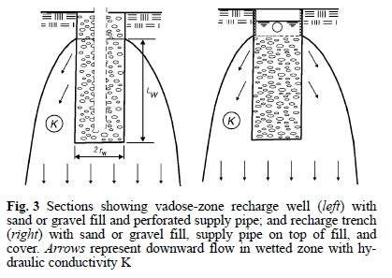
Artificial Recharge of Groundwater
Few examples of direct artificial recharge systems: Vadose-Zone infiltration
Where sufficiently permeable soils and/or sufficient land areas for surface infiltration systems are not available, ground water recharge can also be achieved with vertical infiltration systems, such as trenches or wells in the vadose zone.
Wells:
Typically they are about 1 m of diameter and up to about 60 m deep; backfilled with coarse sand or fine gravel. Water normally is applied through a perforated or screened pipe in the center. Free falling water should be avoided!!
Tranches:
Typically less then 1 m wide and up to about 5 m deep; backfilled with coarse sand or fine gravel. Water normally is applied through a perforated pipeline on the surface of the backfill.
They cannot be pumped for “backwashing” the clogging layer or cleaned to restore infiltration rates. To minimize clogging, the water should be pretreated. It is possible, for trenches, to place a sand filter with possibly a geotextile filter fabric on top of the backfill.

Slide 11
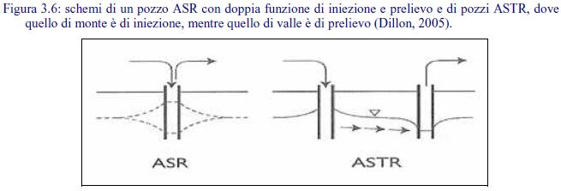
Artificial Recharge of Groundwater
Few examples of direct artificial recharge systems: Wells
Where vadose zones as well are not suitable for trenches or wells, and aquifers are deep and/or confined
The water used for well injection is usually treated to meet drinking-water quality standards for:
minimizing clogging of the well-aquifer interface
protecting the quality of the water in the aquifer, especially where it is pumped by other wells in the aquifer for potable uses.
Where groundwater is not used for drinking, water of low quality can be injected into the aquifers. [in Australia stormwater runoff or treated municipal waste water are injected into brackish aquifers to produce water for irrigation purposes]

Slide 12
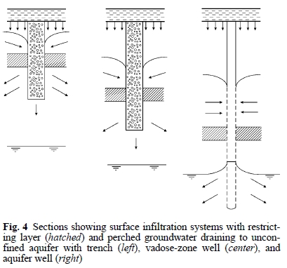
Artificial Recharge of Groundwater
Few examples of direct artificial recharge systems: combination systems
The upper part of the systems function as a drainage system of the perched groundwater, while the lower parts function for infiltration and recharge of the aquifer.
Advantage:
Water as been prefiltered through the soil , so its clogging potential is significantly reduced. However it would be a good practice to regularly pump the well (backwash).
Always attention to:
Water quality!
Soil Clogging!
The gold rule in artificial recharge is to start small (with pilot tests), learn as you go, and expand as needed.

Slide 13
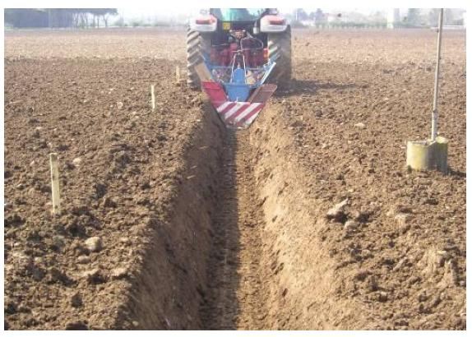
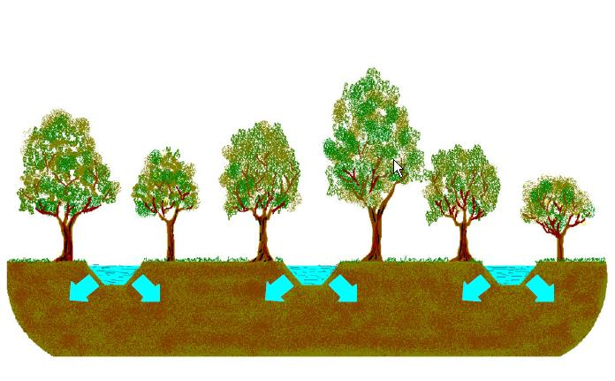
Artificial Recharge of Groundwater – Schiavon (Padova)
Pilot test of artificial recharge of groundwater:
Longitudinal furrows and ditches with trees;
Stormwater infiltrates from September to April

Slide 14
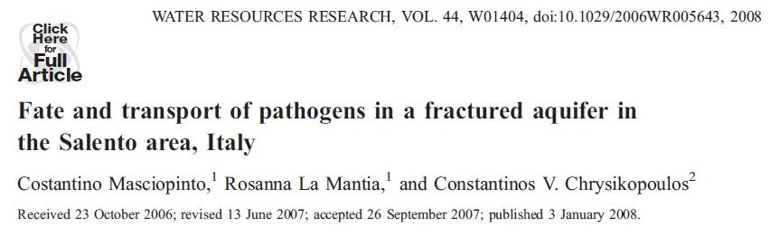
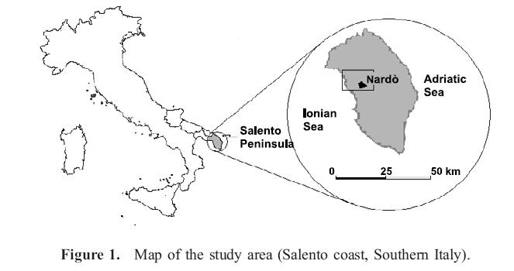
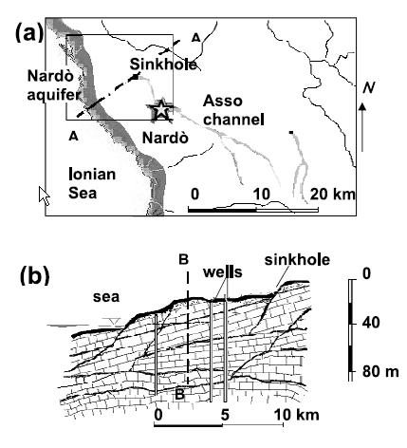
Artificial Recharge of Groundwater – Salento area, Italy
In Mediterranean coastal semi-arid regions, partially treated municipal wastewater is often injected directly into sinkholes for artificial aquifer recharge and prevention of possible seawater intrusion.

Slide 15
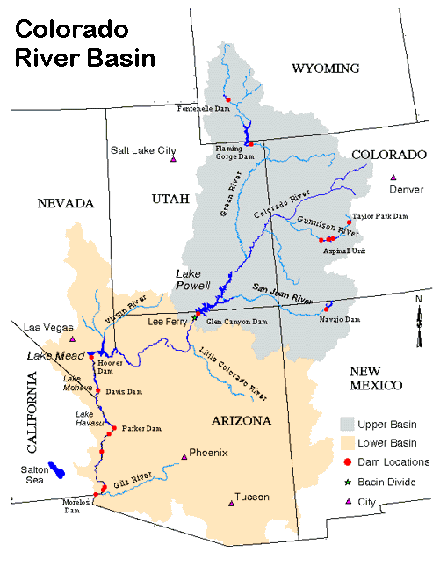
Artificial Recharge of Groundwater – SUBSIDENCE – Las Vegas Valley
Hoover Dam
Lake Mead
[180 km long, almost 35 km³]

Slide 16
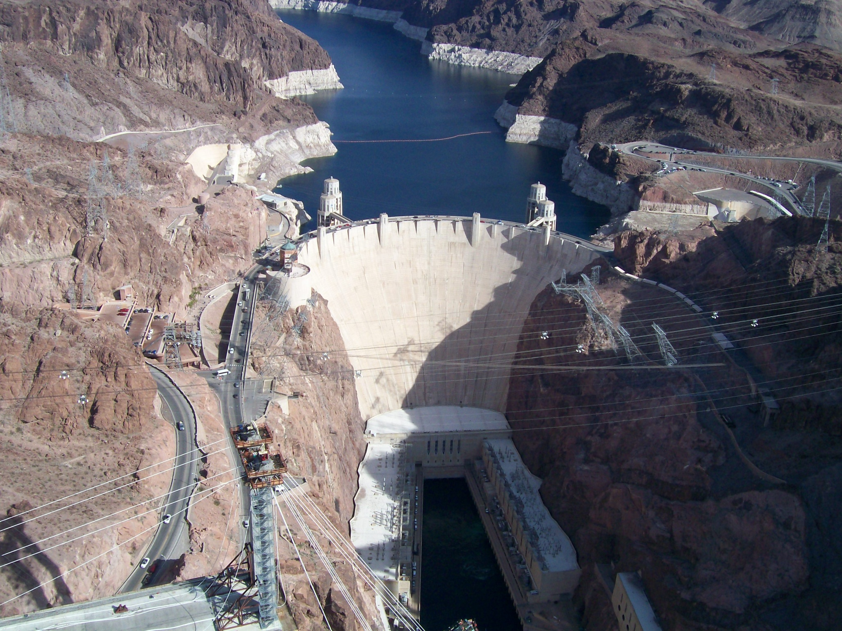

Slide 17
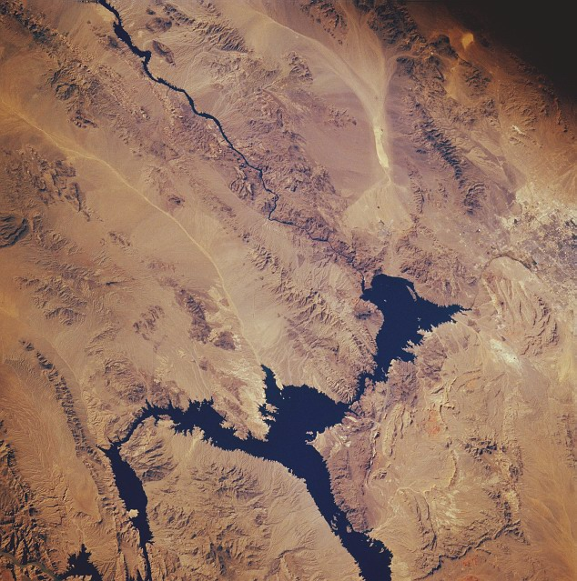

Slide 18
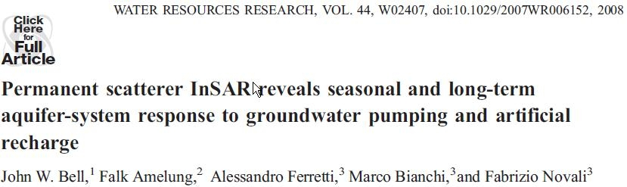
Subsidence
Irreversible process of aquifer storage loss
…. Structural damages, …
The application of a radar monitoring methodology (PsInSAR) allows for greater resolution and accuracy in the detection of groundwater movement produced by aquifer-systems withdrawals and recharge [velocity and acceleration/deceleration analyses permit a close examination of patterns of subsidence and uplift]
population growth starting from ’90
natural springs historically provided water to this arid valley (12 – 20 cm/a average annual precipitation)
groundwater pumping was initiated in 1905 to support early development in the valley and by 1960 groundwater withdrawals had reached about 49 hm³ (40000 acre-ft)
total pumpage increased through 1970 reaching a peak of 106 hm³ per year
in1972 importation of Colorado River water and a stabilization of pumping rates was reached at about 92 hm³
beginning on the late 1980s the Las Vegas valley started an artificial recharge program that injected imported Colorado River water into the principal aquifer during the winter season (annual recharge rate reaching a peak of 39 hm³ )
Notes:
18

Slide 19
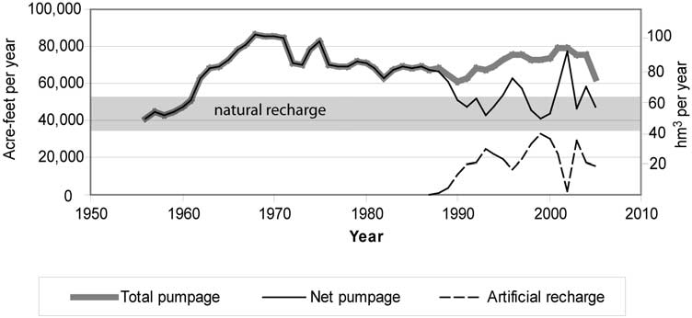
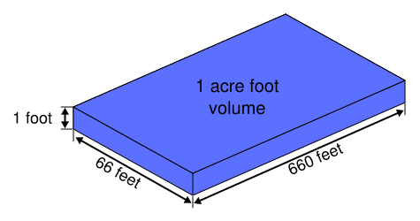
An acre-foot is a unit of volume commonly used in the United States in reference to large-scale water resources.
1 acre-ft =1233,5 m³

Slide 20
Study area
Subsidence had been monitored throughout the valley by conventional methodologies since 1935
Two independent satellite data sets obtained from the European Space Agency

Slide 21
Long-term consequences:
Nonrecoverable compaction of aquitards and regional lowering of the water table level

Slide 22
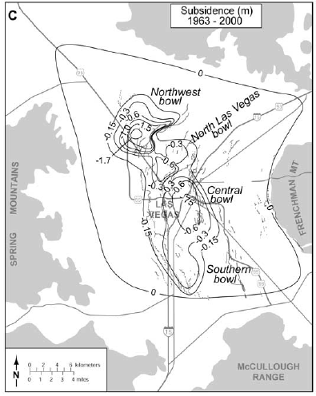
Due to long term effects, in 2000s measured land subsidence was more then 1.7 m

Slide 23
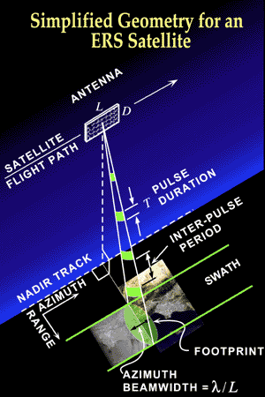
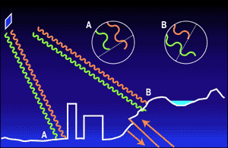
PSInSAR Methodology
InSAR stands for Interferometric Synthetic Aperture Radar. This is thus a remote sensing technique that uses radar satellite images. Those radar satellite shoot constantly beams of radar waves towards the earth and record them after they bounced back off the Earth's surface.
Two information compose the images. One contains how much of the wave bounced back off to the satellite (signal intensity). That depends on how much of the wave has been absorbed on the way and how much has been reflected in the direction of the satellite.
The second information is the 'phase' of the wave.

Slide 24
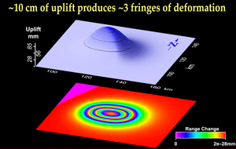
PSInSAR Methodology
Every point in a satellite image (pixel) is carrying those two information: the intensity and and the phase. The intensity can be used to characterize the material in which the surface the wave bounced off is made of and what orientation it has.
The phase is used in another way. When the radar satellite revisists the exact same portion of the Earth, the phase image should be identical. If it is not the case, then something has been going on.
And by combining those two images, we can measure how much and where the ground has moved.
PS methodology utilizes the identification and exploitation of individual radar reflectors that are smaller then the resolution pixel cell and remain coherent over long time intervals.

Slide 25
Subsidence velocity and water table level[1992-1996 greatest subsidence rate]

Slide 26
Subsidence velocity and water table level[1996-2000 reduced subsidence rate]

Slide 27
Subsidence velocity and water table level[2003-2005 largest water recoveries]
Pay attention to the WSB!!!

